Slide 1


Remote monitoring in schizophrenia and psychosis using digital devices
â
Dr Siân Bladon
Post-Doctoral Research Associate
Centre for Health Informatics
University of Manchester

Slide 2
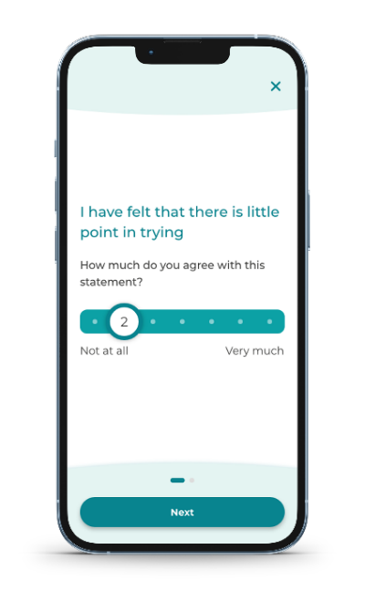
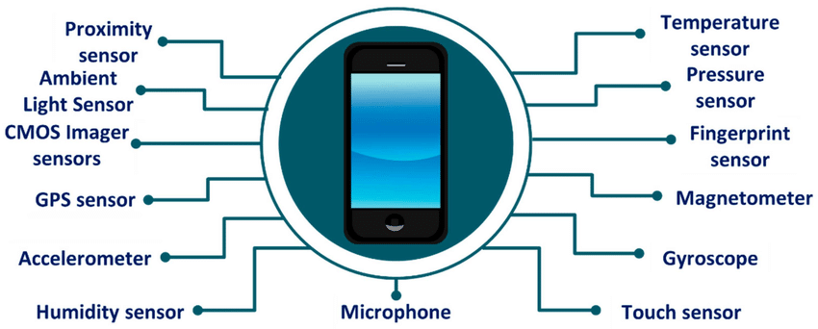
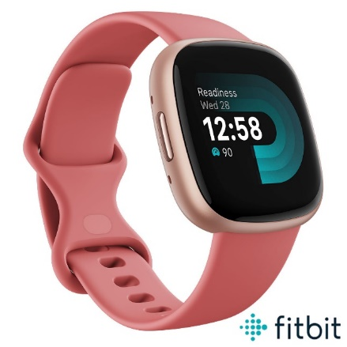
CONNECT Study
Can we use information collected from electronic devices to monitor people with psychosis remotely?
What?
If we can monitor individuals with psychosis remotely and continuously, we can more easily identify signs of worsening symptoms, and intervene to prevent a relapse
Why?
We will collect 3 different types of data from participants and use that data to develop a model to predict the risk of an individual relapsing within the next week or month
How?
Notes:
Aim of CONNECT is to see if we can combine active symptom monitoring data and passive sensing data to develop a clinical prediction model to predict risk of relapse in individuals with psychosis.
Preventing relapse is important as it is associated with high costs to the health service and significant impact to the individual. Monitoring people with psychosis is difficult as contact with HCPs is infrequent.
Participants will respond to questions asking how they are feeling, covering areas such as mood, stress, sleep, anxiety, fear of recurrence, hallucinations, emotions, whereabouts, and social context
Additional data will be collected from smartphone sensors, including GPS, acceleration, pedometer (step count), device & app use, volume of incoming & outgoing calls/messages
A smartwatch will be worn by each participant, collecting data around sleep quantity & quality, activity levels, physiological measures such as heart rate, breathing rate & skin temperature

Slide 3
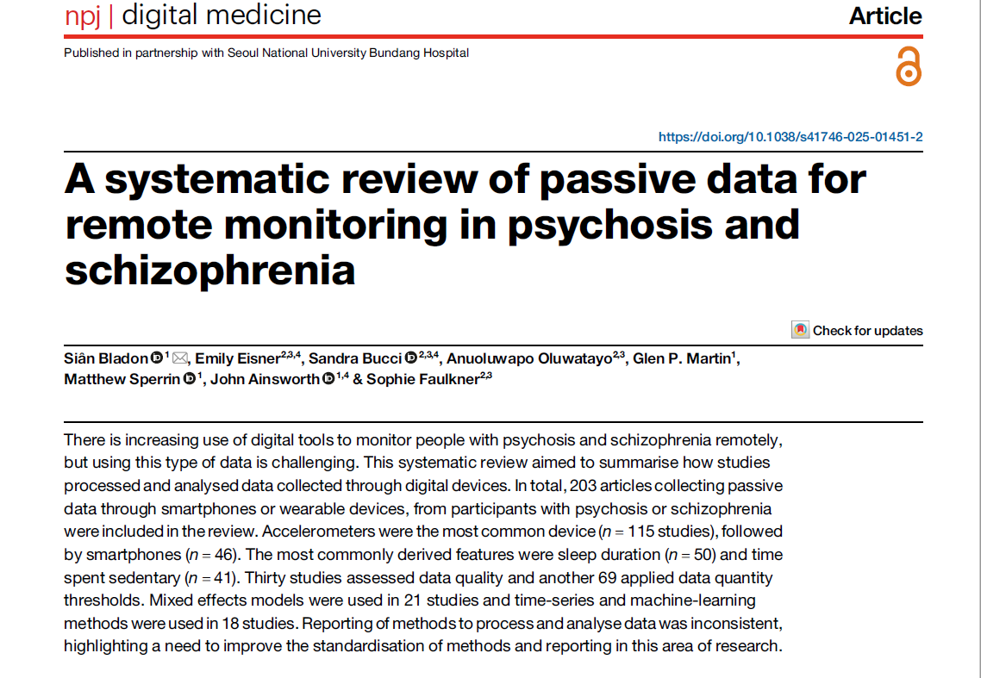
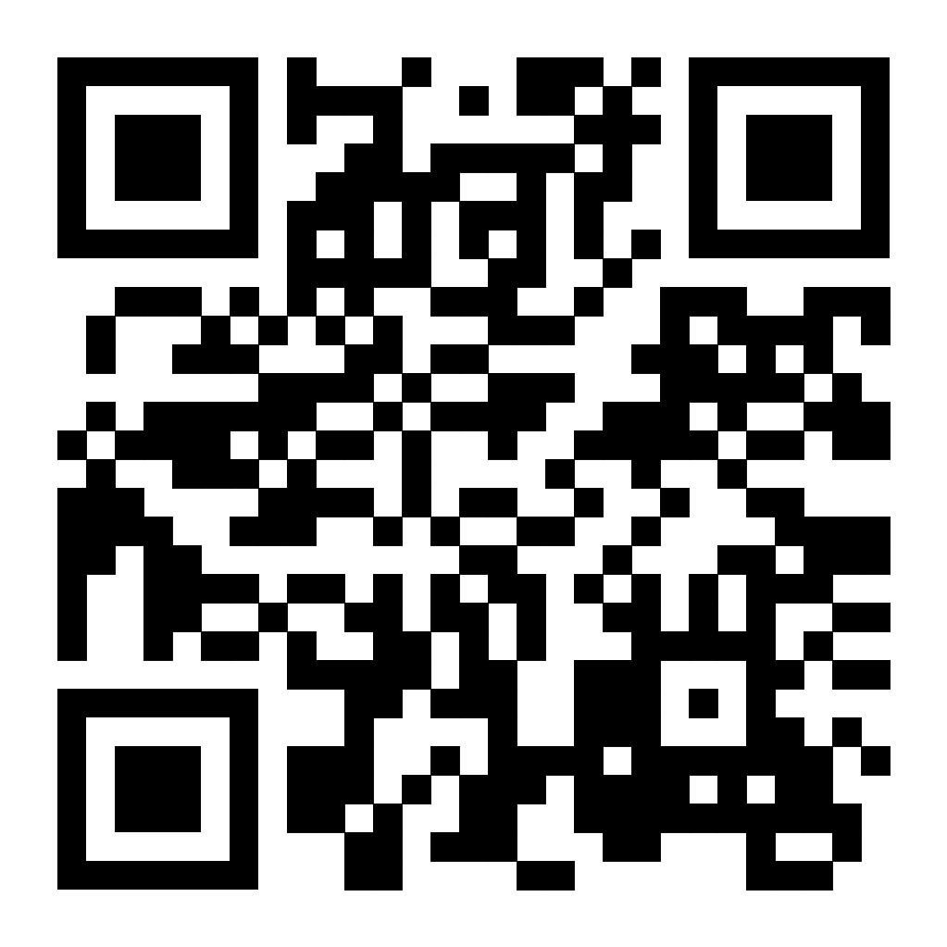
Passive sensing review
Inclusion criteria:
Articles where passive data was collected through smartphones, commercial wearable devices or research-grade devices (e.g. actigraphy devices)
Passive data defined as data collected for >24 hours in uncontrolled settings
Sample must have at least 50% people with psychosis or schizophrenia
Notes:
Published last week. Aim of the review was to summarise methods used to pre-process and analyse passive data collected through smartphones and wearable devices, including what features were extracted from raw data, how this was done, how missing data was handled and how repeated measures were utilised.

Slide 4






Passive sensing review
203
46 studies used smartphones
studies included
115 studies used accelerometers (including actigraphy devices)
Median sample size was
60
21 studies used smartwatches or commercial fitness bands
55%
collected data for 7 days or less
29 studies used other wearables (including adhesive patches and heart rate monitors)
91%
collected data through a single device
12 studies used pedometers
Notes:
Top 10 features for smartphones were location/mobility metrics, inc time in primary location and distance travelled, and phone metadata inc. no. of calls/texts
Top 10 features for smartwatches and commercial fitness bands were sleep (duration & efficiency) and physical activity (amount of sedentary behaviour, light activity etc)

Slide 5
Passive sensing review
Variable extraction
Missing data
Repeated measures
55 studies stated using device proprietary algorithms to derive features
Some open-source methods were used, including methods for processing raw GPS and accelerometer data, and R packages for calculating circadian rhythm metrics
69 studies applied a threshold of data quantity
11 studies imputed missing data, whilst 3 studies used the amount of missing data as a feature/predictor in their analyses
142 studies either did not specify how they had utilised the repeated measurements or had aggregated to a single value
Others used mixed-effects models, time series models or machine learning methods
Overall, the reporting of methods used to process and analyse passive sensor data was inconsistent, which has implications for reproducibility
Notes:
Use of open-source methods more common in recently published studies.
Threshold of data quantity e.g. participants had to have more than 18 hours of data for 7 days to be included in study.
Aggregated to single value e.g. sum or average over time period.
ML methods included neural networks and SVMs.
Greater use of ML and time series data for studies with larger volume of data

Slide 6

Next steps in CONNECT
Use findings & methods from review to begin extracting features from data collected in CONNECT
1
Develop prediction models using variety of modelling strategies
2
PPIE work around the following:
Model performance metrics
Acceptability of different models
Communication of predicted risk
3
Notes:
Using statistical based models and exploratory ML models, which we will compare using a variety of performance metrics.
Lived experience advisory panel involved in development of app, and qualitative analysis already taken place.
Will use their input for what metrics are most important/meaningful e.g. difference between false negatives and false positives
Acceptability of different models, e.g. ML “black box” methods less interpretable, less acceptable?
Communication of risk? If algorithm was integrated into the app in future, how would that be communicated, just to clinicians or to patients as well? How can it be explained?

Slide 7
Thank you!

